Slide 1
Design Specification
Team members:
Mohammad Majid – 2324127
Euan Ferguson – 2323460
Matthew Wilson – 2251532
Jasmine Casey – 2325421
James Bradford - 2324024

Slide 2
Lab 3 Team B – Ask Students
The objective of our app is to allow students or staff in different universities across Scotland to ask and answer questions.
A user will create an account which allows them to post questions and post answers to questions. A user can associate their account with a university.
There will be a number of different categories one can post questions in. New categories can be requested by users, and then approved by admins. From the home page, it will be possible to view the latest questions, the top questions, and a list of unanswered questions.
A user posting a question will be able to mark their question answered by selecting their favourite answer to the question. Other users will be able to like and dislike answers, which will contribute to the answerers overall likes and dislikes on their profile.

Slide 3
Design Specification
A site visitor must be able to:
View categories, questions and answers
Browse through categories, search for question and answers
Create an account to become a registered user
View a registered user’s profile
A site admin must be able to:
Do everything a registered user can do
Add/edit/delete questions and answers
Approve/deny a request to create a category
A registered user must be able to:
Do everything a site visitor can do
Log in and log out of their account
Update their profile and delete their account
Ask and answer questions
Request for a new category
Mark their questions as answered
Like or dislike other users’ answers
Edit any of their questions or answers

Slide 4

User Persona 1: Billy Bob – Student
General Description:
Billy is a 20 year old student studying Computing Science and Stats in Glasgow University. Billy spends every day studying and working hard to maintain good grades, however he does need a little extra help sometimes with assessments. He spends most of his time on the computer and doesn’t go out much.
Frustrations:
Billy suffers from social anxiety, he feels like everyone else is smarter and more capable than him. As a result, he has no friends and struggles asking people for help with homework and assessments. Billy does not like sending emails to lecturers for help because he feels he's wasting their time on trivial issues.
Goals:
He wants to achieve good grades
He wants to make some friends
Needs:
Billy wants to be able to ask questions casually to other students and lecturers without the embarrassment and pressure of real life interaction.
He also has no friends, so he needs a way to find some outside of class.

Slide 5

User Persona 2: Montana Brown – Student
General Description:
Montana is a 18 year old student studying Physics in Glasgow University. Montana travels on the train for two hours to University every day. She only spends a few hours in university, and then goes to work at her part time job after university during the week. The only time she has to do university work/assessments is on the weekends.
Frustrations:
Because her time is limited to the weekends, lecturers and other resources become unavailable, and her friends always have plans because they complete their university work during the week. So nobody is around to help her when she needs it.
Goals:
She wants to achieve good grades
She wants to find out things she missed due to her busy schedule
Needs:
Montana needs to be able to seek help from other students and lecturers on the weekend.
She also needs to keep up to date with things happening on campus, as she spends very little at the university.

Slide 6
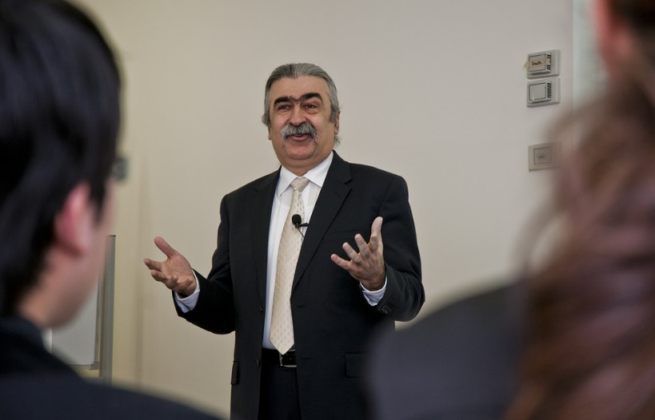
User Persona 3: Doctor David Kanas – Lecturer
General Description:
David is a 45 year old Mathematics lecturer, who has been working at Glasgow University for 8 years. He lives in the outskirts of Glasgow and drives into work each day, and spends the weekends at home with his family. He is also rather old school, and prefers to use pen and paper over technology as much as possible, and as such he has only limited IT experience.
Frustrations:
Among all his work commitments, David does not find enough time during the week to answer all of the questions students have during his limited office hours, and lecture times. He wishes there was a more convenient way than emails to assist his students outside class times, especially weekends.
Despite his limited understanding of technology, he is willing to try to use an online system to solve his problem, but fears it will be too complex for him.
Goals:
To help his students understand course content.
To ensure students understand what is expected of them during the course.
Needs:
David needs to be able to find and answer questions from his students as quickly and easily as possible.
He also needs a system that is easy to understand and use.

Slide 7
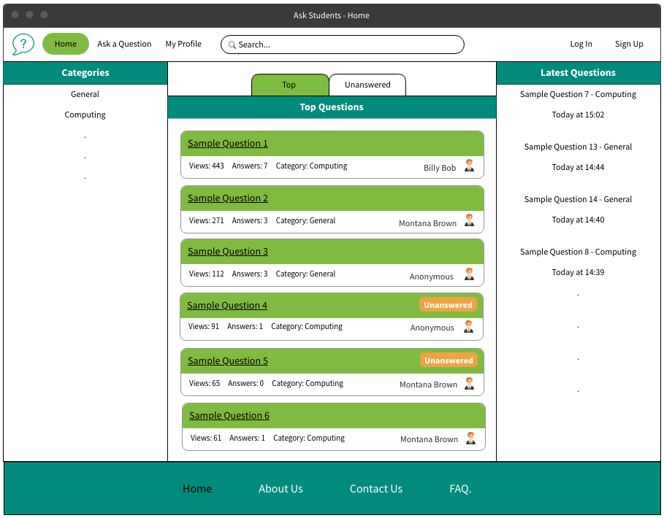
Wireframe 1
Home page

Slide 8
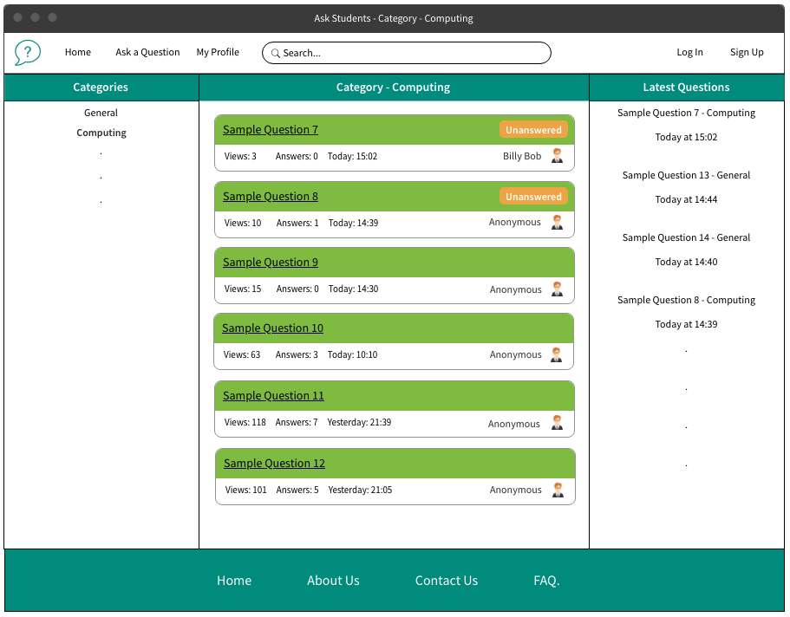
Wireframe 2
Category

Slide 9
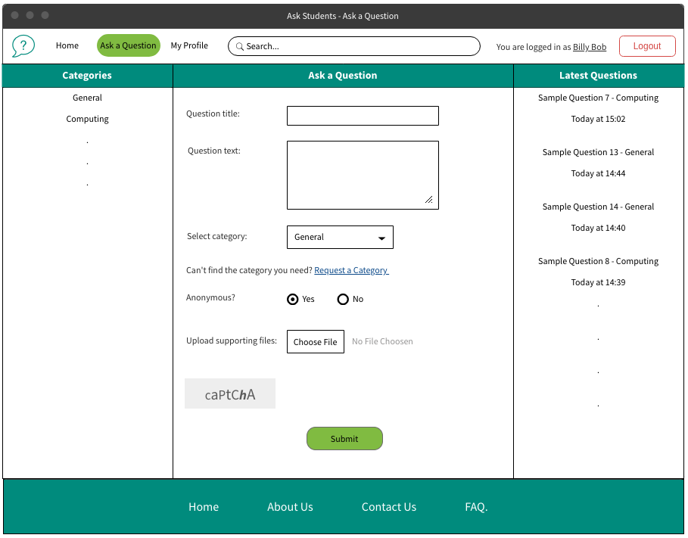
Wireframe 3
Ask a Question

Slide 10
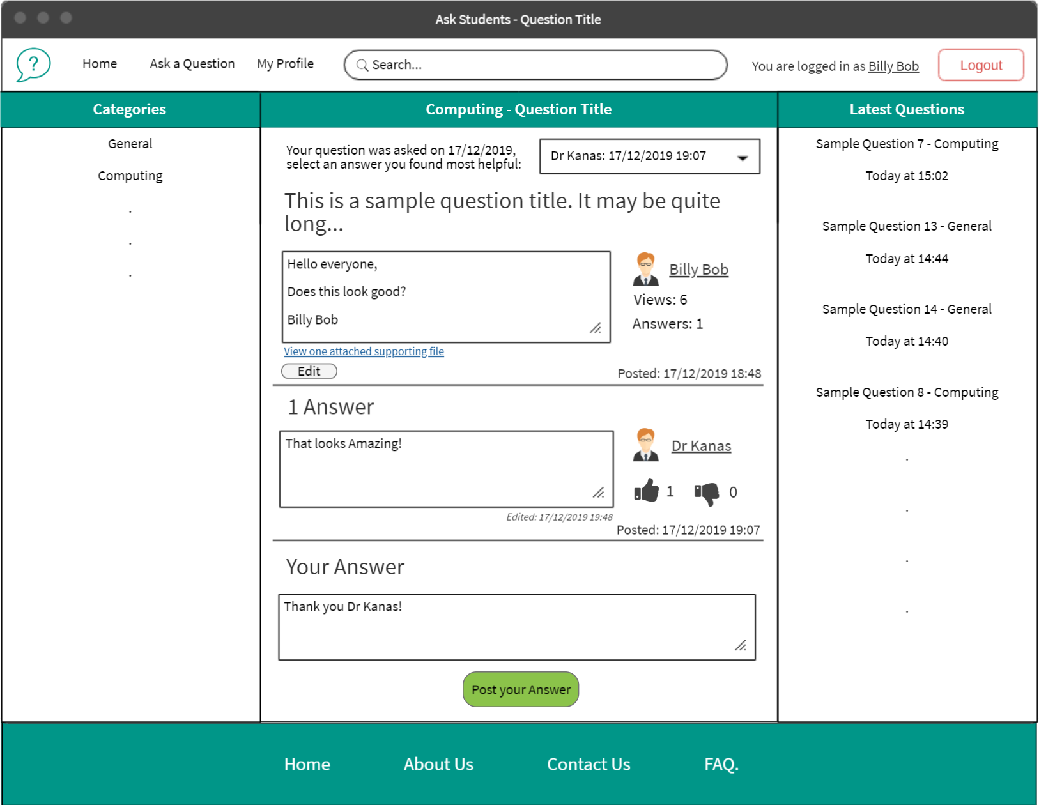
Wireframe 4
Question

Slide 11
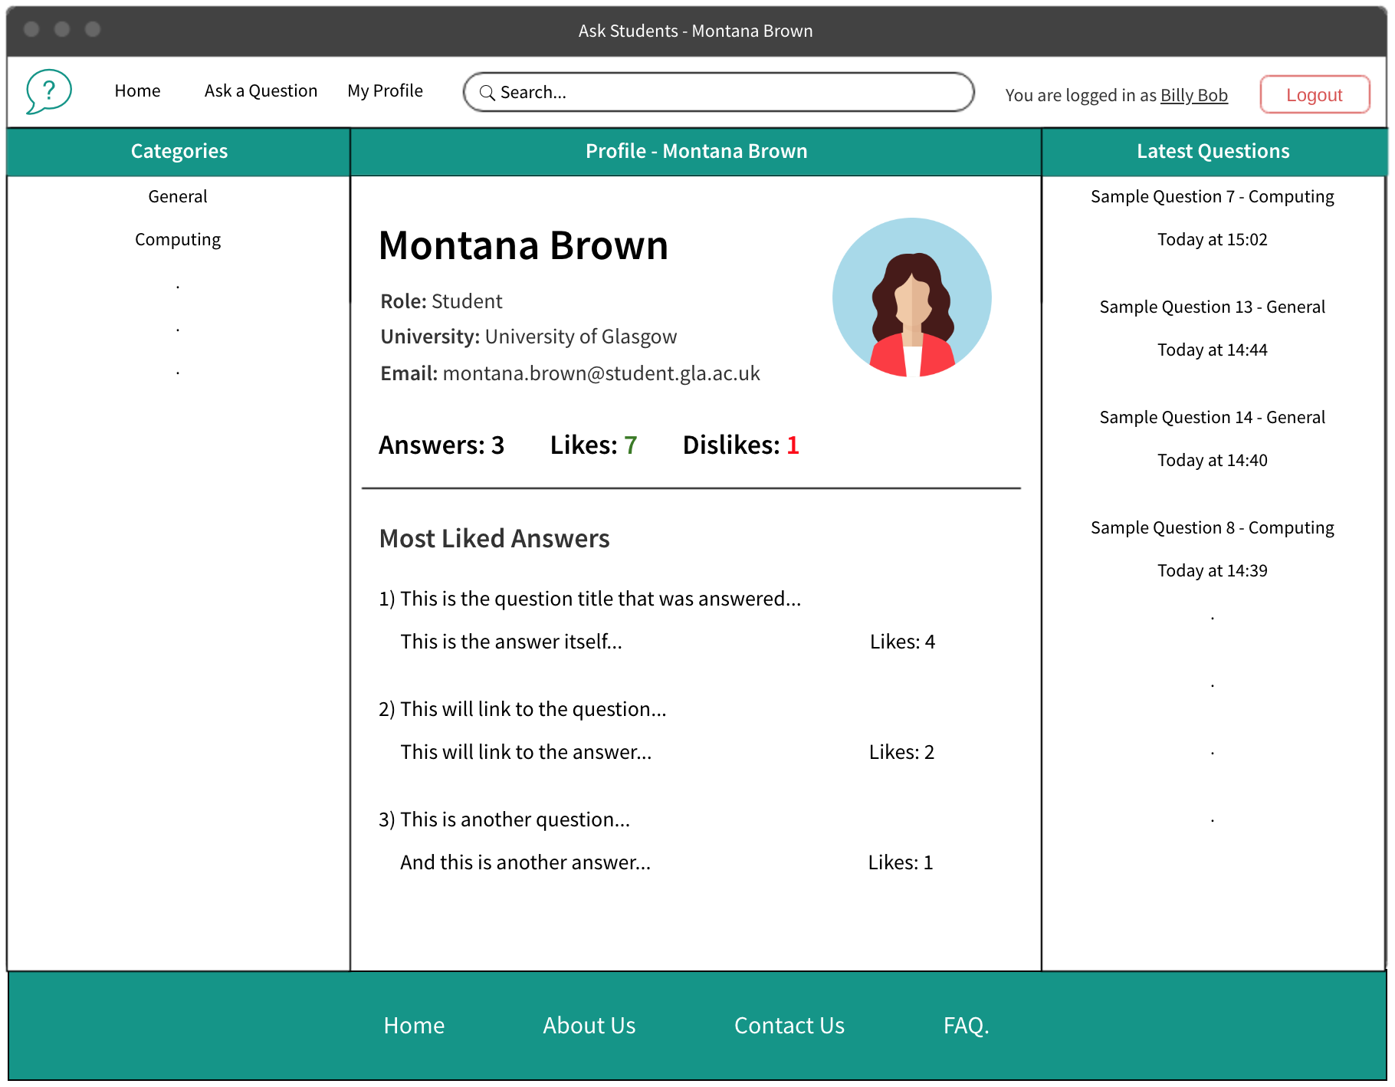
Wireframe 5
Profile

Slide 12
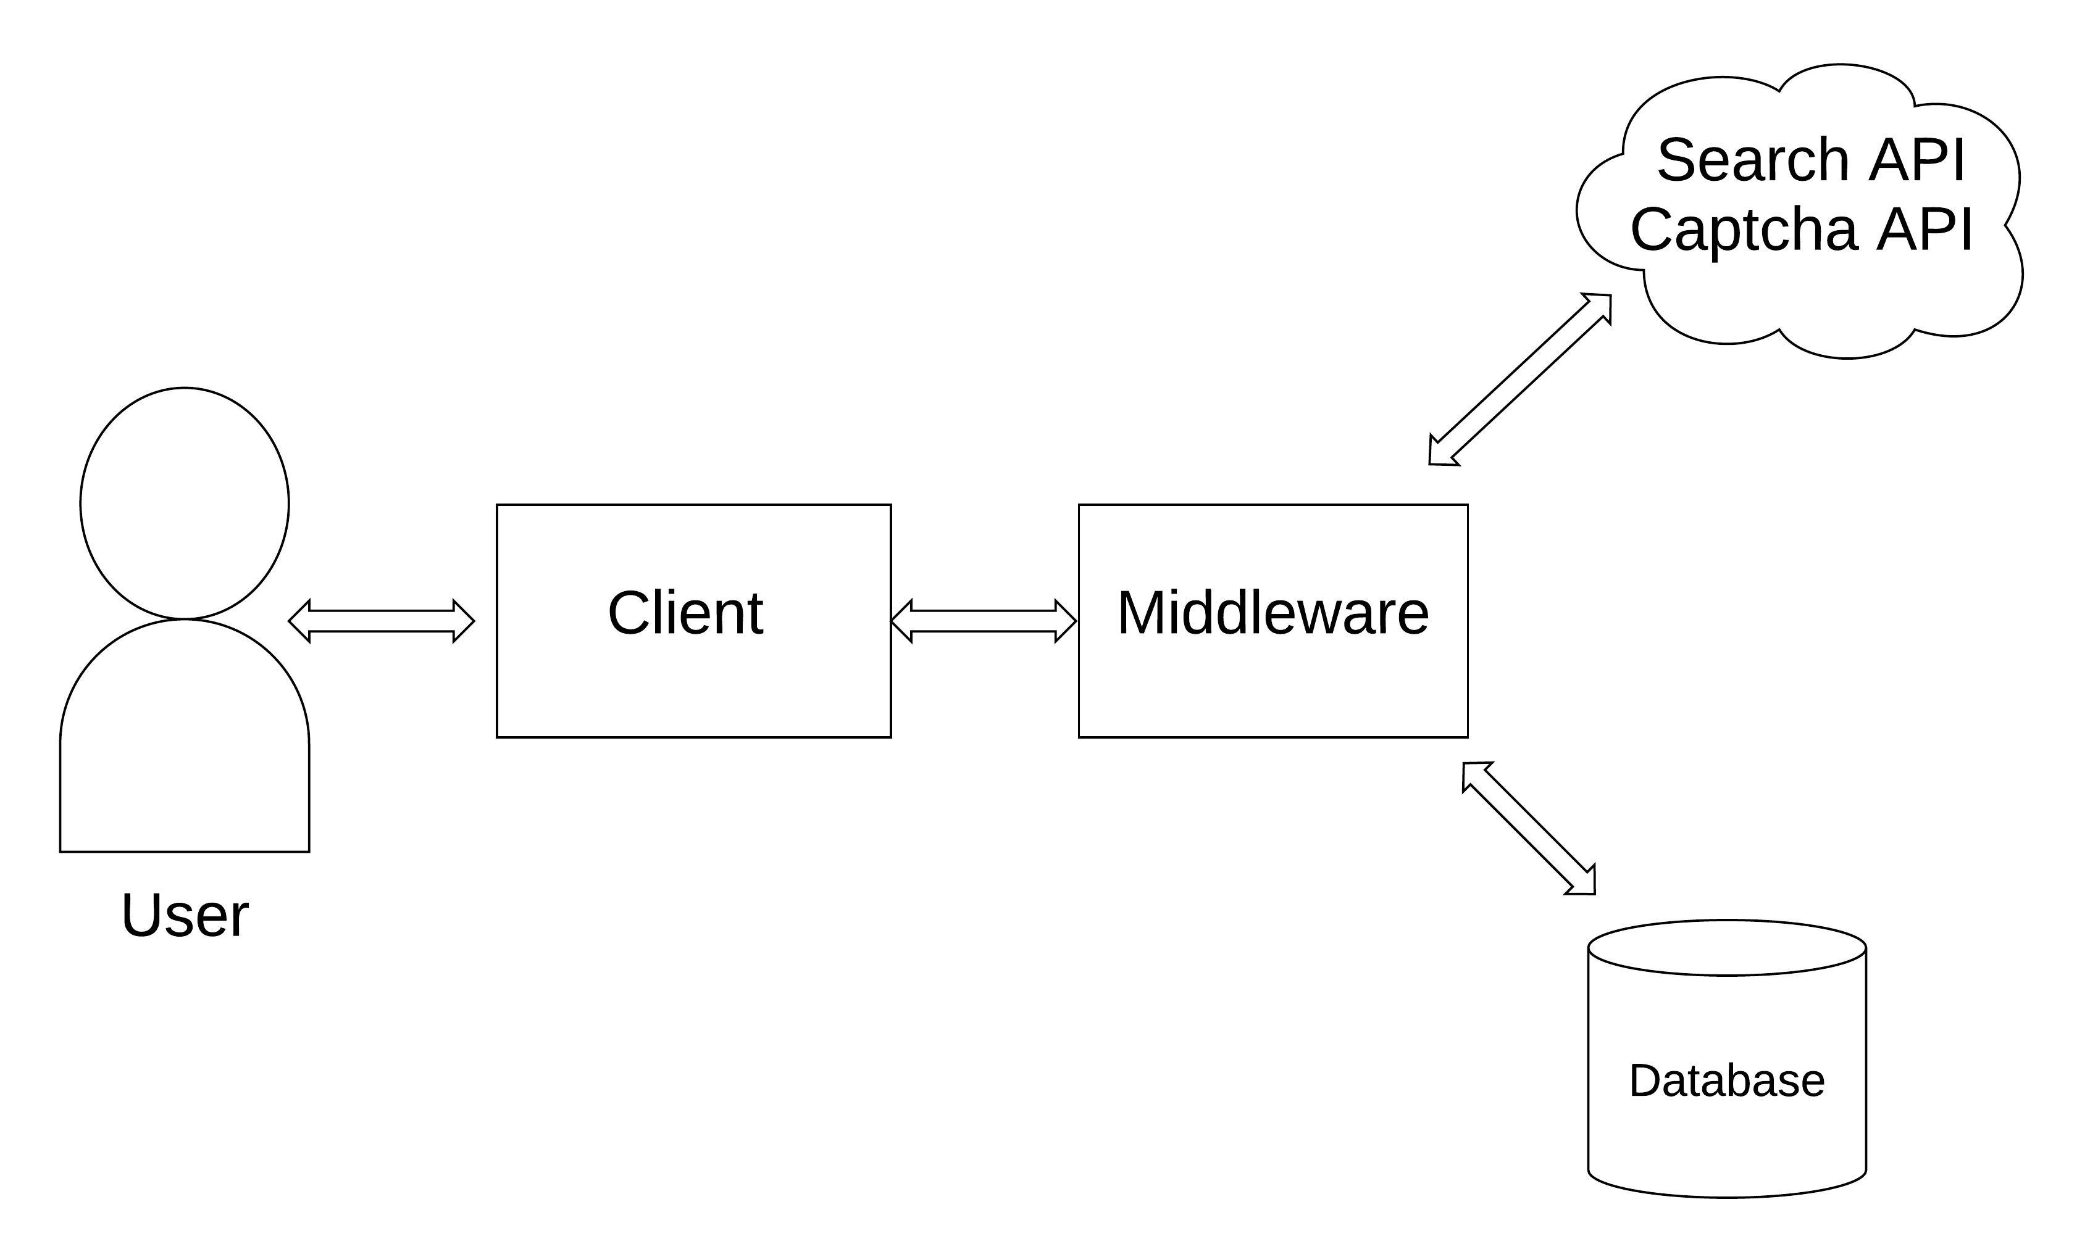
System Architecture

Slide 13
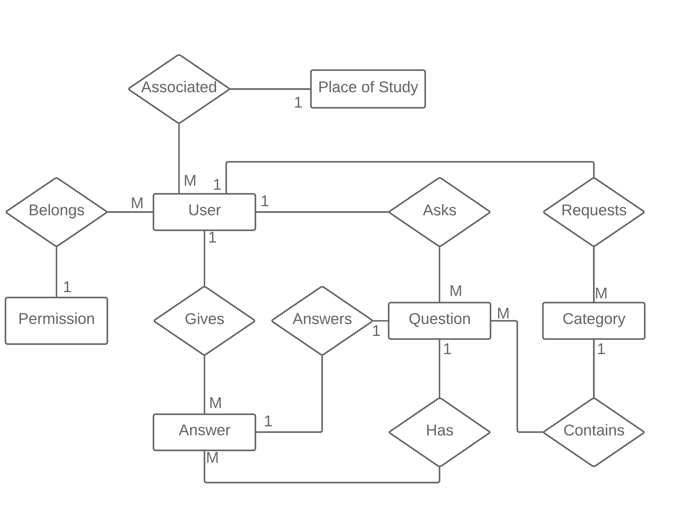
Answer
Question
Field | Type
id | Integer (PK)
text | Char(4096)
likes | Integer
dislikes | Integer
posted | Datetime
edited | Datetime
user_id | Integer (FK)
category_id | Integer (FK)
Field | Type
id | Integer (PK)
name | Char(128)
text | Char(4096)
answered | Integer (FK)
anonymous | Boolean
posted | Datetime
edited | Datetime
views | Integer
user_id | Integer (FK)
category_id | Integer (FK)
ER Diagram
Permission
Field | Type
id | Integer (PK)
title | Char(128)
User
Category
Field | Type
id | Integer (PK)
password | PasswordField
display_name | Char(32)
bio | Char(4096)
email | EmailField
likes | Integer
dislikes | Integer
place_of_study | Integer (FK)
permission | Integer (FK)
image | ImageField
Field | Type
id | Integer (PK)
name | Char(64)
description | Char(512)
approved | Boolean
user_id | Integer (FK)
Place of Study
Field | Type
id | Integer (PK)
title | Char(256)

Slide 14
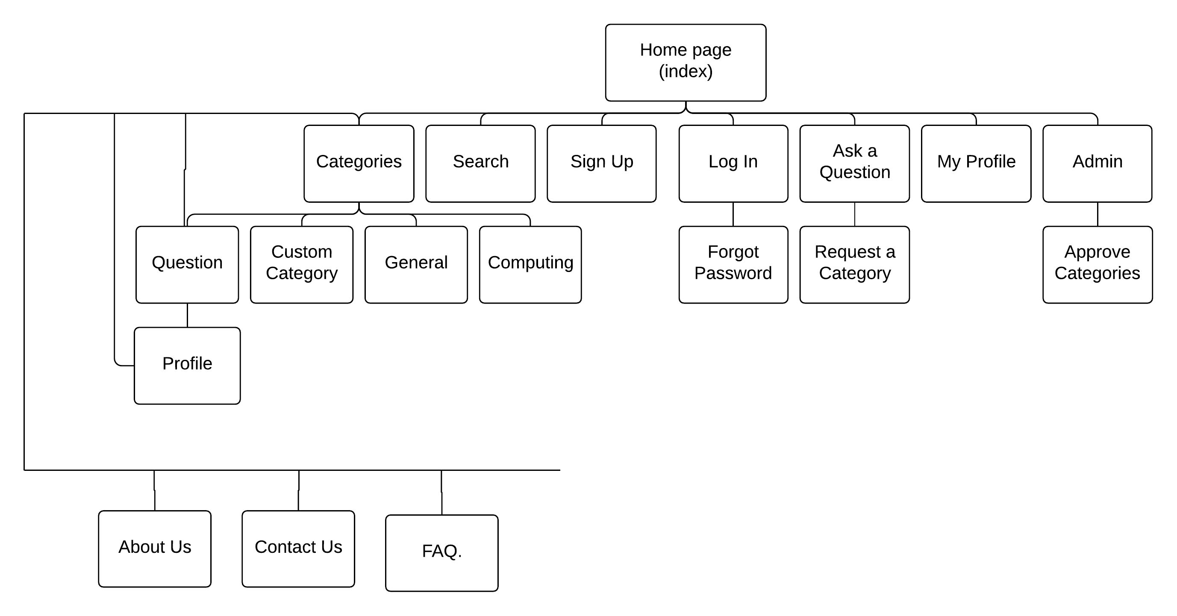
Site Map

Slide 15
Site URLs
/home | /account/signup
/about-us | /account/login
/contact-us | /account/forgot-password
/faq | /myprofile
/category | /profile/user-id
/category/general | /approve-categories
/category/computing
/category/custom-category-here
/category/category-name/question-id
/ask-a-question
/ask-a-question/request-category

